Slide 1
Early Detection Methods for COVID-19
By: Akash Koneru, Mohamed Bin Adi, Louis Constable, Shubham Mishra

Slide 2
Project Objective and Background
Why choose this topic?
We decided to do this study mostly as a result of how directly covid 19 affected us. This virus caused millions of deaths throughout the world. Every member of this team is deeply invested in this work, which is essential to protecting millions of people worldwide from this terrible virus.
Some people with COVID-19 have no symptoms at all, hence early detection methods will allow us to catch COVID-19 promptly.
Different strains are developing since it is important to check for it.

Slide 3
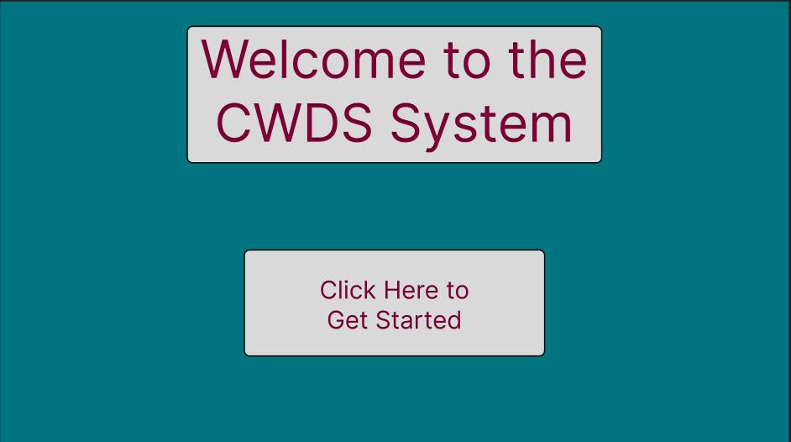
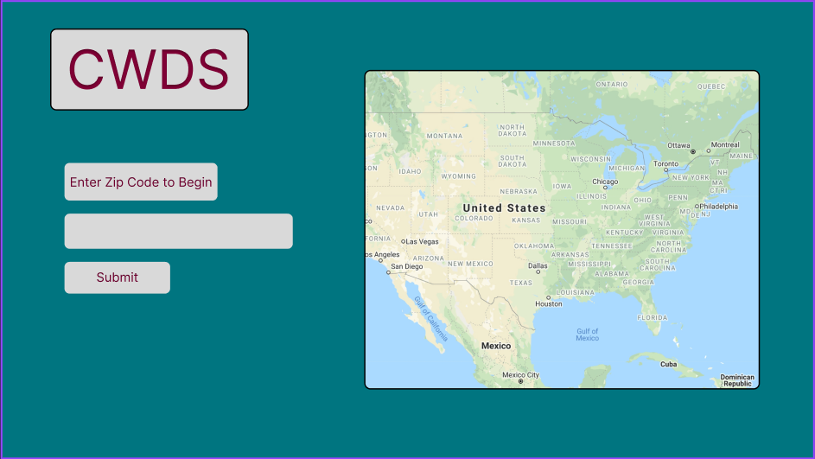
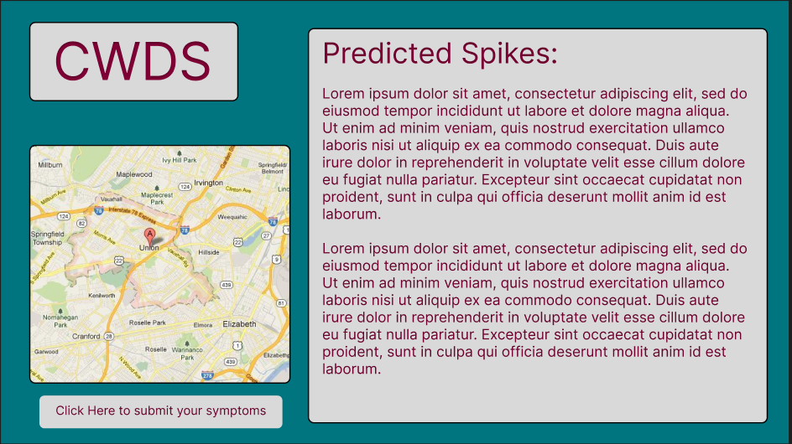
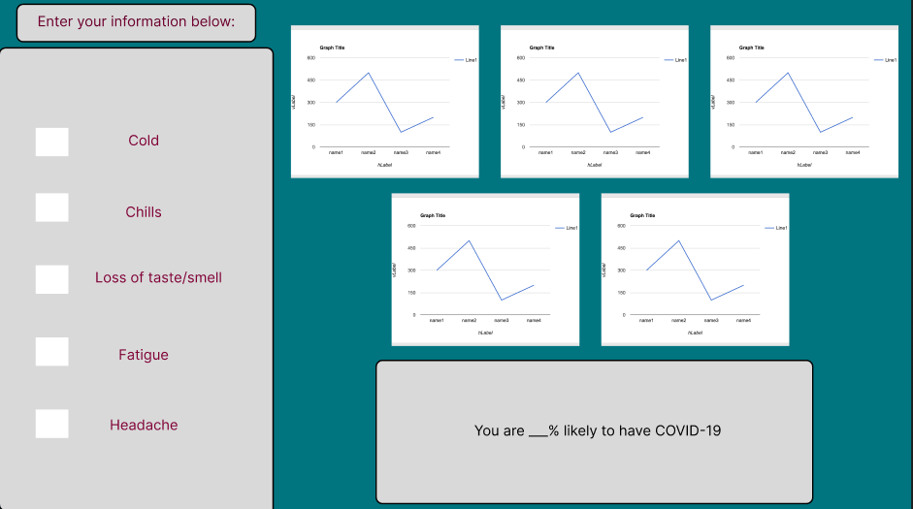
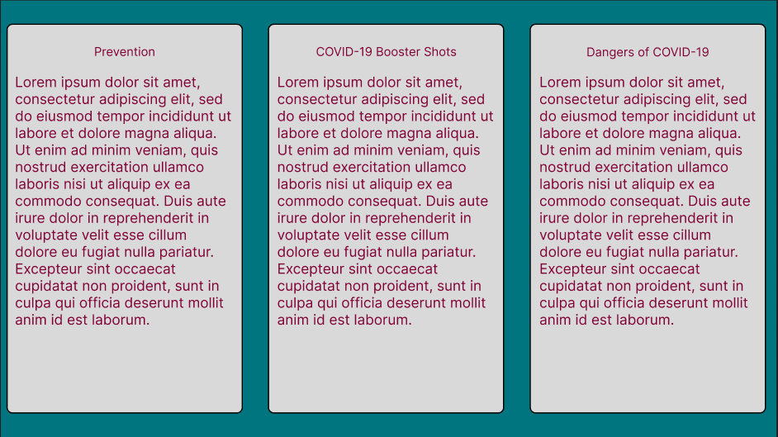
Potential Interface and dashboard
*Color scheme subject to change (we are not the most artistic group in the world)

Slide 4
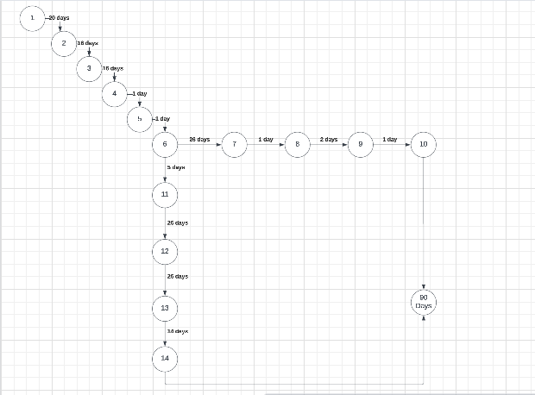
Overview of methodology
Data Collection: 1/10/2023 - 1/20/2023
Front-End: 1/31/2023 - 2/31/2023
Back-End 1/31/2023 - 2/31/2023
Team Meetings 1/10/2023 - 2/31/2023
Application Hosting- ???
Class Deliverables 1/10/2023 - 4/20/2023

Slide 5
Current Work Completed (Collection)
Data Collection:
We have collected relevant historical related to waste water data that we can use as a proof of concept.
Using the data collected by our parent paper which has the Covid viral loads within specific counties in the US.
We also have found a way of finding google trends within given time frame.
Using Pytrend we are able to call the google API through the package and allows for the search trend data to be collected between points for different lengths.

Slide 6
Current Work Completed (Implementation)
Code Implementation:
We created a shared jupyter notebook for us to explore the different options with the backend.
Because of how long the Deep Neural Network takes to run we have been seeing if running the code locally is a better solution than hosting the code on Google Servers.
We have a separate document for experimenting with the Pytrend package in order to integrate it with the other aspects of our backend.
Front End:
Explored many different options for creating the app, we’ve narrowed our options down.
Our options that we are still experimenting with are PowerBI, Flask, RShiny, Jango, Dash.
We’re leaning towards Flask and Dash but nothing is set in stone for now.

Slide 7
Immediate Next Steps
Front and backend work is in progress
Still deciding on what direction we want to take for our front end portion
Frontend - in progress
Code is Python and R based and will be completed in google colab
Backend - in progress
Google trends API implementation
Machine Learning for detecting probability of COVID-19 disease
Connecting Deep Learning code to our GUI for detecting potential spikes in COVID-19 in different areas of the US

Slide 8
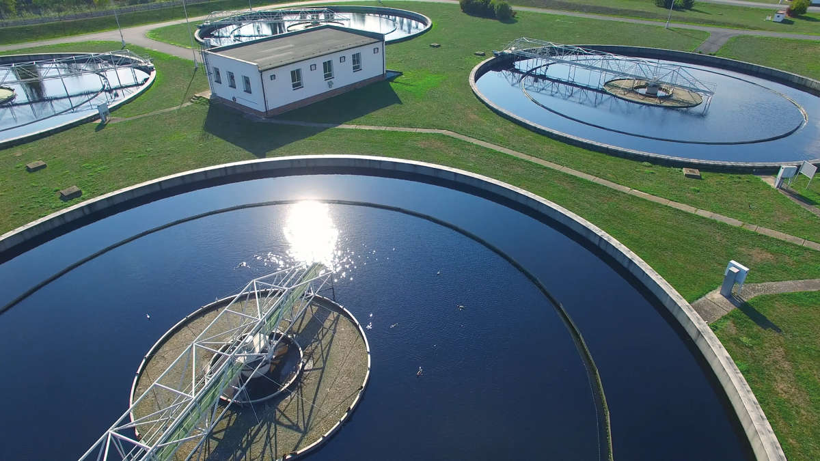
Future Work
We will be implementing a machine learning model to predict the possibility of a user having COVID-19 based on the symptoms they have.

